Slide 1


DIGITAL CURRENCY
TEAM ALGORITHM UNLOCK

Slide 2







New Currency Perks
Ground Reality How ?
Implementation Example
Meet our team

Slide 3




NEW CURRENCY
We are planning to bring Digital Currency (DC) which will be used for the transactions in financial transactions and the NGO/Non Profit organization .The sole administrator and distributor of the digital currency(DC) will be the banking sectors and would be directly regulated by RBI. The main concept of the revolutionary idea is to monitor and analyse large sets of transactional data between banks and other financial institutions and identify as well as mitigate patterns of money flows which are indicative of money laundering, terrorist financing, or other financial crime.

Slide 4


Regulation of Tax-payers.
All the financial organization /companies and NGO/NPO operating in the economy would be
regulated and channelized.
PERKS
3. To keep a track on the funds exchange between banks and other financial institutions.
To reduce the ambiguity in the cash exchange or transfer procedures, as these escape clause lead to unethical usage of INR such as terrorists funding ,
black money and money laundering .
Ease of doing business for the small scale business-man.

Slide 5



GROUND REALITY
Our idea revolves round the basic fact that in today’s fast-moving world it is impossible to keep a track of the liquid cash flowing between all the institutions and
inside the banking sector, so we came up with the following idea. This will be a pan India movement. All the companies, NGO/NPO's will be given a time frame of 2-3 months so as to register themselves under this scheme,
failing to do the same would lead to legal actions against them. after the all the organisations have been registered, they would be given a identity which in term would make them recognised as a company which can do business in India.
FOR EXAMPLE
HALLMARK:JEWELLERY :: REGISTRATION WITH DC: CERTIFIED BY ROC

Slide 6



HOW IT
Their would be just one rule so as operate in the market, i.e. there
WORKS
would be no use of INR, all the companies which will be operating in
the market would have to make the deals in the form of DC . the digital currency can only be sanctioned by the banks, where 1 INR= 1 DC.
Now the organisation can exchange the INR to DC, from any of the banks they have an account with, by simply showing the
certificate they received after joining the DC scheme. now how would the transactions occur, for that we will be
designing a new gateway specially designed DC transactions, which will be keeping the track of all the money flow via DC

Slide 7

Any use of INR in the business would be an illegal crime, they need to do the transactions with the help of DC only.
Now for say they these organizations collab with the NGO/NPO for any sort of event, even the transactions made to the NGO/NPO would be done through the DC, all the transactions that would be made by people other than
normal people for their household will be done in the form DC. DC can only be sanctioned by the banks, no other institute Since during all this the actual currency that is INR would be safe in the banks, this can in the meantime be used for money creations process.

Slide 8

IMPLEMENTATION
All the financial organization and NGO/NPO operating in the economy would be regulated and channelized.. After the flow of digital currency around the country all the transactions made from the financial organizations which includes banks to bank transfer or company to NGO/NPO transfers will have a
track and detailed information about the transaction. Each and every transactions will be tracked by RBI so that there would not be any kind of misuse of the money. The companies and banks need to have this new digital currency which can be bought with the help of INR. Large transactions are to be done in this DC mode only and this will work under a certain gate way. In that gate-way each and every details of the transactions are to be mentioned which may include.

Slide 9

Name of the both the parties date of transaction account details,location of the transaction as well as the the amount transferred using DC. If this method is implemented then there would be very clean detailed of each and every large transactions which can be tracked by RBI any moment if there is any kind of suspicious things happened.
Every bank/ company should use this method so that we could reduce the risk of other financial attacks.

Slide 10
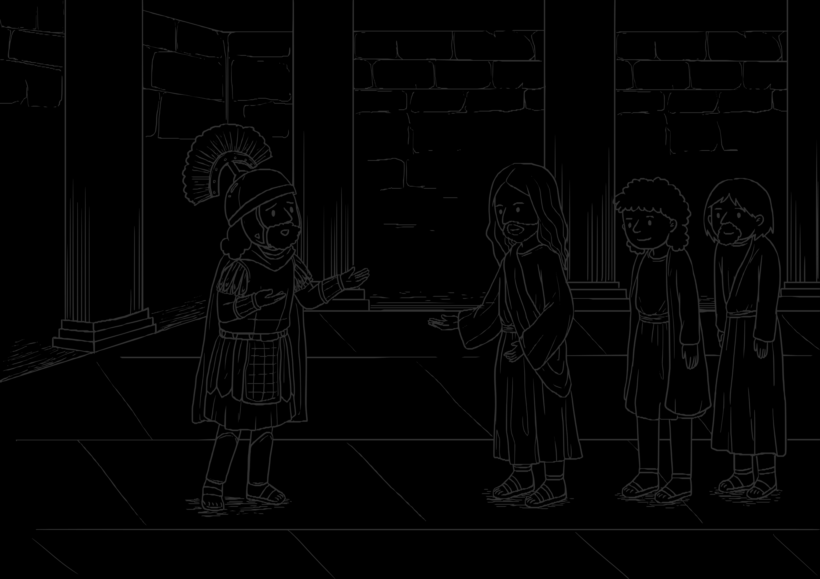
EXAMPLE
We all know about the Scam of 1992 that how the man and his company used the security of the banks to buy stocks and how he change the records with the help of clerk of the bank.This happened due to the manual record tracking of the funds.Let us assume that the concept of dc would have been at that the time,the rbi could have been easily known the scam before it happened by seeing the DC server records.

Slide 11






TEAM ALGORITHM UNLOCK
JYOTIRMAY NAYAK
PRAYASH MOHAPATRA
MITHILESH MISHRA
IPSIT NAYAK

Slide 12


